Slide 1

A Project Review Meeting on Pharmacy Inventory Managment
By
Name B.Koushika vardini roll 2520030459
Name N.Satwika roll 2520090015
Team Number: 2
Under the guidance of
Dr. D.Pavitra
Assistant Professor
Department of Computer Science and Engineering
Koneru Lakshmaiah Education Foundation (Deemed to be University estd. u/s. 3 of the UGC Act, 1956) Off-Campus: Bachupally-Gandimaisamma Road, Bowrampet, Hyderabad, Telangana - 500 043. Phone No: 7815926816, www.klh.edu.in

Slide 2
Outline of the Presentation
Abstract
Introduction
Problem Statement
Project Flow Diagram
Objectives with Justification
Modules[Frontend web pages]
Expected Outcomes of the Proposed Work
Conclusion
References

Slide 3
Abstract
The Pharmacy Inventory Management System is designed to simplify the process of managing medicine inventory in a pharmacy. Manual methods are often prone to errors and can lead to stock shortages or expired medicines. This system provides an efficient way to maintain medicine records, monitor stock availability, and track expiry dates. It includes features such as inventory management, low-stock alerts, and data export. Developed using HTML, CSS, JavaScript, and Local Storage, the system improves accuracy, reduces manual work, and enhances overall inventory management.

Slide 4
Introduction
• Pharmacy inventory management is an essential part of healthcare operations.
• Manual record keeping can lead to stock shortages, expired medicines, and data errors.
• The Pharmacy Inventory Management System helps in maintaining accurate medicine records.
• It allows users to add, update, search, and delete medicine information efficiently.
• The system monitors low-stock medicines and expiry dates to improve inventory control.
• Developed using HTML, CSS, JavaScript, and Local Storage for easy and efficient management.

Slide 5
Problem Statement
• Manual pharmacy inventory management is time-consuming and prone to errors.
• Tracking stock levels and expiry dates manually can lead to shortages and expired medicines.
• An efficient system is needed to manage medicine records and inventory accurately.

Slide 6
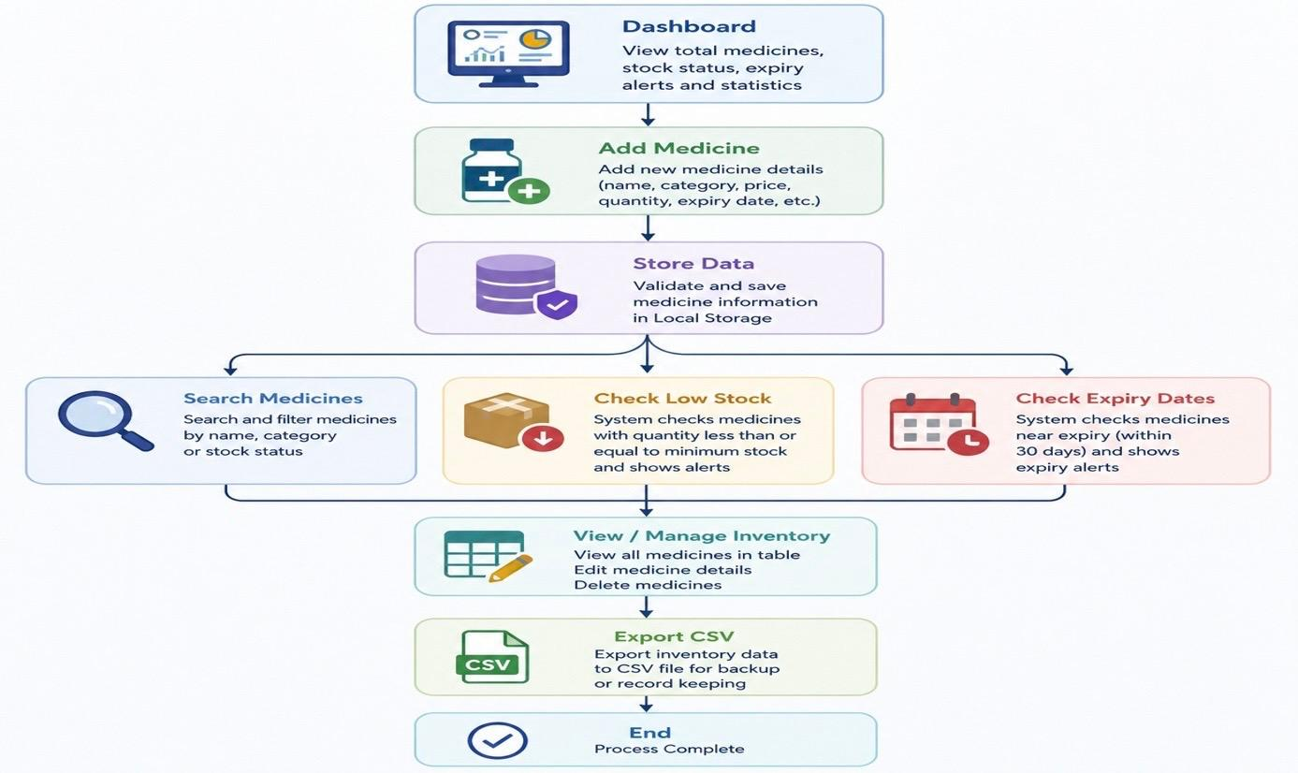
Project Flow Diagram

Slide 7
Objectives with Justification
1. To maintain medicine inventory records efficiently. Justification: Reduces manual paperwork and improves record accuracy.
2. To monitor stock levels of medicines. Justification: Helps prevent medicine shortages by identifying low-stock items.
3. To track medicine expiry dates. Justification: Ensures timely removal of expired medicines and improves patient safety.
4. To provide quick search and update facilities. Justification: Saves time and allows easy management of medicine information.
5. To generate inventory reports through CSV export. Justification: Helps maintain backups and simplifies record keeping.
6. To improve overall pharmacy inventory management. Justification: Enhances efficiency, accuracy, and decision-making in pharmacy operations.

Slide 8
Modules [Frontend web pages]
CO | Topics Used in Pharmacy Inventory Management System
CO1 | Components, Virtual DOM, Props (Data Flow)
CO2 | ES6 JavaScript, Async/Await, Import/Export Modules
CO3 | Components, Props, State (useState), Hooks (useEffect)
CO4 | State Management, API Integration, Error Handling
CO5 | React Router, Forms, Validation
CO6 | Vite, npm, Deployment

Slide 9
Expected Outcomes of the Proposed Work
• Efficient management of medicine inventory records.
• Quick identification of low-stock and near-expiry medicines.
• Reduced manual errors in inventory tracking.
• Faster searching, updating, and maintenance of medicine data.
• Improved accuracy and productivity in pharmacy operations.
• Easy backup and reporting through CSV export.

Slide 10
Conclusion and Future Scope
The Pharmacy Inventory Management System successfully simplifies inventory management by providing accurate tracking of medicines, stock levels, and expiry dates. It reduces manual work and improves efficiency in pharmacy operations.
In the future, the system can be enhanced with database integration, user authentication, barcode scanning, billing features, automated notifications, and cloud storage to make it more suitable for real-world pharmacy environments.

Slide 11
References
• HTML5 Documentation • CSS3 Documentation • JavaScript Documentation • Local Storage API Documentation • Visual Studio Code Documentation

Slide 12
Thank you

